Slide 1

sust-AI-nable
Checkpoint: 2
Multi-Agent Cloud Carbon Optimization System
Problem: Cloud workloads and AI pipelines generate significant carbon emissions, yet developers and organizations lack tools that translate emissions data into actionable infrastructure decisions.
Our Goal: Build an AI-agent system that retrieves carbon data, analyzes workloads, and recommends lower-carbon execution strategies with explainable reasoning.
Notes:
“Our project addresses the growing environmental impact of cloud infrastructure and AI workloads. While cloud providers provide carbon reporting tools, developers still lack intelligent systems that help them make sustainable infrastructure decisions. Our goal is to build a multi-agent system that analyzes workloads and recommends lower-carbon execution strategies.”

Slide 2

What We Needed to Validate:
Key Assumptions from CP1
Developers would benefit from carbon-aware infrastructure recommendations
Sustainability dashboards are too complex for decision making
AI agents could assist in reasoning about sustainability trade-offs
Validation Methods
Pilot interviews with developers and governance stakeholders
Prompt experiments using LLM tools
Prototype dashboard simulation
Notes:
At the start of the project we had three main assumptions.
First, we believed developers would benefit from carbon-aware infrastructure recommendations.
Second, we assumed that current sustainability dashboards are difficult for developers to interpret when making infrastructure decisions.
Third, we wanted to test whether AI agents could help reason about sustainability trade-offs between carbon emissions, cost, and performance.
To validate these assumptions, we conducted pilot interviews, prompting experiments with AI tools, and built a small prototype dashboard simulation

Slide 3


Prompting Protocol & Validation Design
AI Tools Tested
Cursor – system architecture & simulation data
GitHub Copilot – debugging multi-agent pipeline
NotebookLM – research synthesis
ChatGPT – sustainability reasoning
Prompt Categories
Typical Case: Carbon-aware workload scheduling Edge Case: Cost vs carbon trade-off reasoning Failure Case: 30-day multi-agent simulation
Notes:
To validate our concept, we conducted prompting experiments across multiple AI tools including ChatGPT, Cursor, Copilot, and NotebookLM.
We structured these experiments using three categories: typical cases, edge cases, and failure cases.
Typical cases tested whether models could reason about carbon-aware workload scheduling. Edge cases evaluated cost versus carbon trade-offs. Failure cases simulated a multi-agent system running for 30 days with synthetic workload data.
This approach helped us understand both the strengths and limitations of LLM-based sustainability reasoning.

Slide 4
Validation Reflection
Team Member | Contribution | Key Insights | Design Impact
Pooja | Professional interviews with cloud engineers, governance professionals, and AI developers | Sustainability is rarely considered during system design because existing tools are retrospective and difficult to interpret. Engineers lack visibility into energy impact and developers receive no feedback on carbon impact. | Led to the idea of real-time sustainability decision support integrated into engineering workflows.
Sarthak | Industry interviews with data engineers and risk professionals | Carbon data is fragmented across infrastructure layers and difficult to retrieve. Existing tools lack developer-focused sustainability guidance and natural language interfaces. | Motivated the use of a multi-agent system capable of retrieving emissions data and generating recommendations.
Josue | User interviews on carbon awareness and footprint tools | Users care about environmental impact but rarely calculate their carbon footprint because tools require too much data and lack transparency. Participants preferred simple inputs and actionable recommendations rather than just emissions numbers. | Reinforced the need for simple interaction and explainable recommendations rather than complex dashboards.
Notes:
My interviews with professionals showed that sustainability is rarely considered in everyday engineering workflows because existing tools are retrospective and difficult to interpret.
Sarthak’s interviews with data engineers highlighted technical challenges in retrieving carbon data across distributed cloud systems.
Together these insights revealed that existing tools focus on measurement, but users actually need decision guidance.”
Josue’s interviews with students revealed that people care about environmental impact, but they rarely calculate their carbon footprint because current tools require too much data and lack transparency.
Key Insight: Users want guidance on reducing emissions, not just measuring them.

Slide 5

Evidence
What Worked?
What Failed
Identified lower-carbon cloud regions
Generated sustainability optimization suggestions
Explained carbon-aware scheduling decisions
Helped prototype system architecture
Token limits during multi-agent simulations
API rate limits during long orchestration cycles
Agents repeated reasoning loops without new data
Emission factor sources were rarely cited
Notes:
Our prompting experiments also revealed both strengths and weaknesses of current AI tools.
On the positive side, models were able to identify lower-carbon regions and generate sustainability optimization suggestions.
However, we also encountered several limitations.
During our multi-agent simulation, the system sometimes hit token limits and API rate limits. In some cases the agents also entered reasoning loops where the same workloads were evaluated repeatedly without new data.
Another issue was that emission factor sources were rarely cited, which raises concerns about reliability.
These failures were actually valuable because they helped us refine the design of our system.
Failures were the most valuable part of our experiments

Slide 6

Gap Analysis & Opportunity
Platform | What They Do Well | Key Limitation | Opportunity for Our System
Plan A | Carbon accounting, ESG reporting, Scope 1–3 emissions tracking | Focuses on reporting and compliance dashboards | Lack of real-time infrastructure optimization
Normative | Accurate carbon footprint calculation and regulatory reporting | Primarily used for enterprise reporting and sustainability teams | Does not guide developers on compute-level decisions
Traditional Carbon Tools | Measure and report emissions data | Post-hoc analysis after emissions occur | No automated decision support
Most platforms measure carbon emissions. Few systems actively guide how to reduce them in real-time.
Notes:
We also analyzed existing carbon management platforms like Plan A and Normative.
These platforms are very strong in carbon accounting and ESG reporting. They help organizations measure emissions across Scopes.
However, they primarily operate at the organizational reporting level.
Developers and infrastructure teams still lack tools that help them make sustainability decisions during workload deployment.
This reveals a gap between carbon measurement systems and carbon-aware decision systems.”
Most tools measure carbon. Few tools help reduce it in real time

Slide 7


Concept Evolution
Initial Idea: Multimodal AI scheduling assistant
Workload
LLM
Suggest region
The system was only predicting recommendations, not making decisions.
Refined Concept: Autonomous sustainability decision agent
Agents decide:
• Where workloads should run • When they should run • How to balance carbon, cost, and performance
Notes:
Our initial idea was to build a multimodal AI assistant that could recommend lower-carbon scheduling options.
However, during validation we realized that this approach essentially created a fancy scheduling assistant.
The system was predicting recommendations but not actually making decisions.
So we refined the concept.
Instead of simply suggesting regions, our system now allows agents to decide where workloads should run, when they should run, and how to balance carbon, cost, and performance.
This shift moved the system from a recommendation tool to a decision-support system for sustainable infrastructure

Slide 8
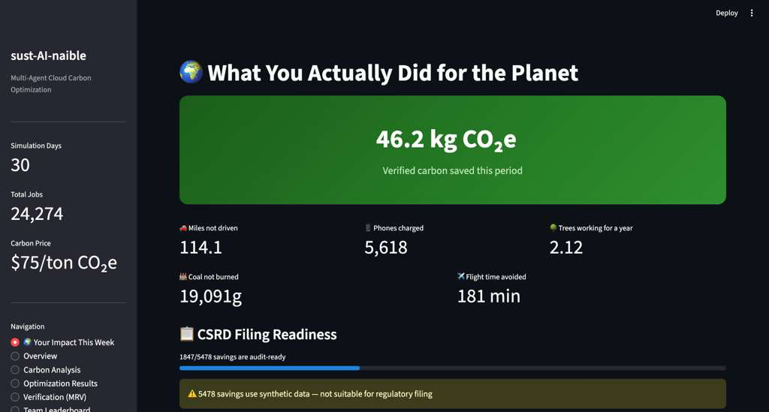
Refined System Concept
Notes:
Based on our findings we designed a multi-agent architecture.
A carbon analyzer agent retrieves emissions data.
A compute optimization agent evaluates infrastructure efficiency.
A decision advisor agent generates sustainability recommendations and explains the reasoning behind them.
Together these agents help developers make better infrastructure decisions before workloads are executed

Slide 9
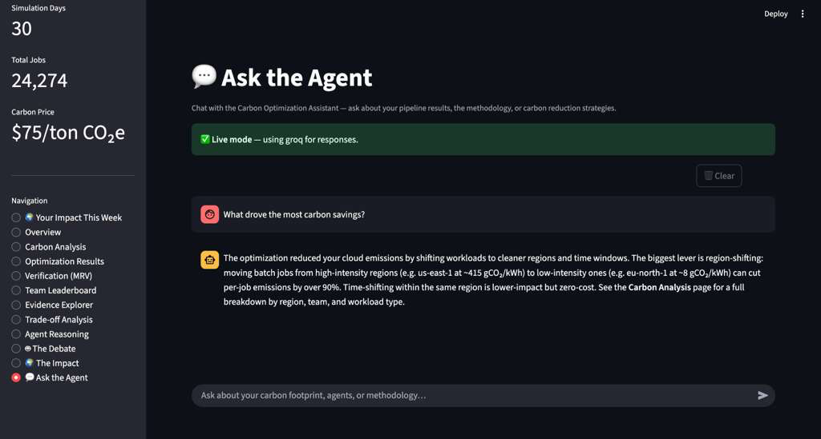

Slide 10
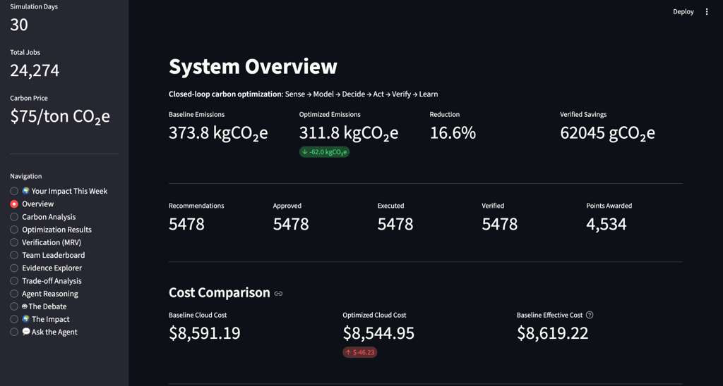
Notes:
Our goal is to move from carbon reporting to carbon-aware decision systems.
Most sustainability platforms today focus on measuring emissions after infrastructure runs. Our work explores how AI agents could help organizations make better decisions before workloads run by combining carbon data, system optimization, and explainable reasoning.

Slide 11

Risks & Next Steps
Risks Identified
Safeguards
• Unreliable emissions data • LLM hallucinations • Orchestration instability
Deterministic carbon calculations
Verified emissions data sources
Termination safeguards for agent workflows
Checkpoint 3 Goal:
Notes:
Through our experiments we identified several risks.
These include unreliable emissions data, potential hallucinations in LLM reasoning, and instability in multi-agent orchestration.
To address these risks, we plan to implement deterministic carbon calculations, verified emissions data sources, and safeguards that prevent infinite reasoning loops.
For Checkpoint 3, our goal is to build a working prototype that integrates real emissions data and improves the stability of the agent system.

